Slide 1

Fraud Cash Detection using
Image Processing
Presented by:
Pathlavath Divya 245621733047
Gundupalli Thanusha 245621733020
Gadiraju Sravya Santhoshi 245621733016
Name of the Guide: Mrs. N. Meghana

Slide 2
Abstract
The increasing amount of counterfeit currency creates a strong economic threat and requires reliable detection methods. Fraud cash detection systems make use of advanced image processing techniques and machine learning algorithms to identify genuine currency notes from counterfeit ones. This paper presents an effective framework that incorporates image acquisition, preprocessing steps such as gray scale conversion, edge detection, feature extraction, and segmentation with robust classification models. The currency notes are analyzed for key features under various conditions, including ultraviolet light, to enhance the accuracy of detection. Machine learning algorithms, such as Naïve Bayes, Support Vector Classifiers (SVC), Gradient Descent, and Neural Networks, are trained on the extracted features to classify currency as authentic or counterfeit. This integrated approach ensures high precision and reliability in fraud cash detection, addressing the growing threat of fake currency circulation. The results show the possibility of using computational image processing together with intelligent classification models in developing reliable and scalable fraud prevention solutions.

Slide 3
Problem Statement
Counterfeit currency circulation poses a significant threat to the economy by reducing the value of genuine currency and facilitating illegal activities. Manual detection methods are time-consuming, prone to human error, and not always reliable, especially when fake notes are made with high precision. There is a need for an automated, efficient, and accurate system that can detect counterfeit currency using advanced technologies. This project aims to develop a system that utilizes image processing and machine learning techniques to automatically detect fraudulent currency notes by analyzing their visual features and patterns.

Slide 4
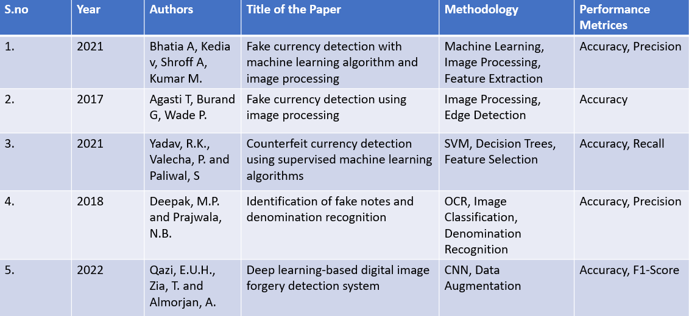
Literature Review

Slide 5
Requirements
SOFTWARE REQUIREMENTS
HARDWARE REQUIREMENTS
Operating System: Windows, macOS, or Linux (Ubuntu recommended)
Programming Languages: Python
Machine Learning Frameworks: TensorFlow
Image Processing algorithms
Development Tools: Google colab
Libraries: NumPy, OpenCV, Pandas, Matplotlib, Scikit-learn
CPU: Intel Core i3/i5 or equivalent (multi-core recommended)
RAM: Minimum 8 GB (16 GB recommended for smooth deep learning model training)
Storage: Solid-state drives (SSDs) with at least 50 GB of free space

Slide 6
Methodology
The project starts with collecting images of real and fake currency notes. These images are preprocessed by converting them to grayscale, resizing, and removing noise. Important features like texture, color patterns, and edges are extracted from the images. A machine learning model such as KNN is then trained using these features to classify notes as real or fake. The model is tested for accuracy and performance. Optionally, a simple user interface can be developed to allow users to upload a currency note image and get instant detection results.

Slide 7
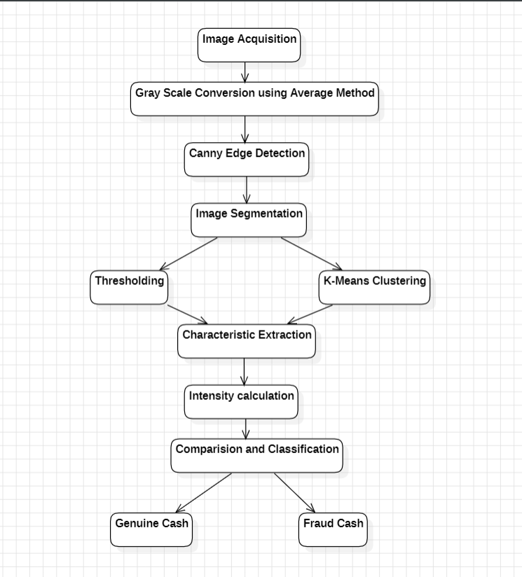
System Architecture

Slide 8
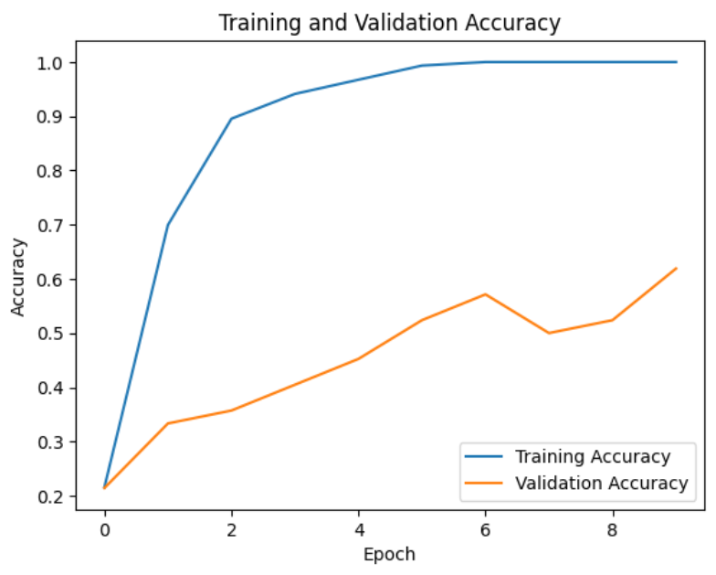
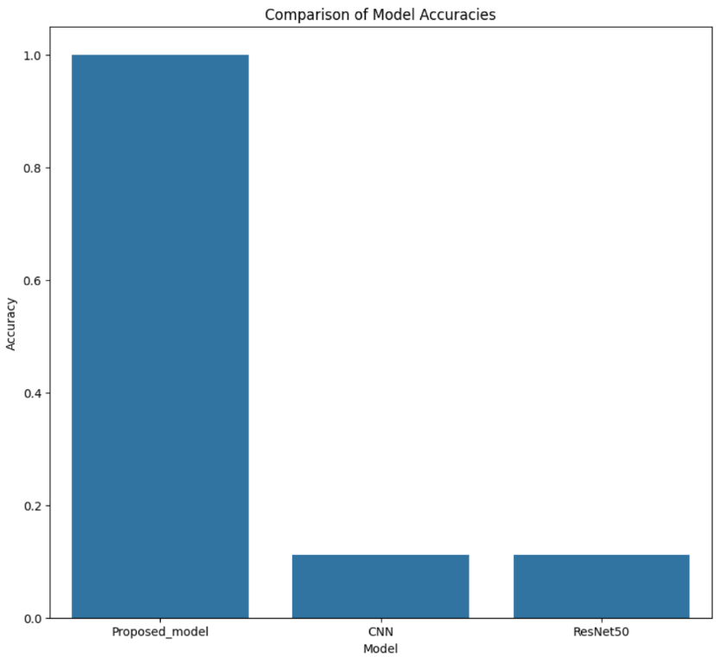

Results

Slide 9
Conclusion
This project demonstrates the potential applicability of computer vision and machine learning to detect the counterfeit currency notes in a fast and efficient way. Computer vision has distinctive property in the ability to visualize, and train a model through classification based on the existence of differing technologies such as OpenCV which enables preprocessing of the images, and TensorFlow or Scikit-learn which enables training of the models. Our project will determine the currency images to be either real or fake based on indicating meaningful visual features of currency images. The project has advanced on ancient, manual methods of detection as well as developed a remedy that will be used in financially checking in an automated, scalable, and more trust-worthy manner.

Slide 10
References
Bhatia, A., Kedia, V., Shroff, A., Kumar, M. and Shah, B.K., 2021, May. Fake currency detection with machine learning algorithm and image processing. In 2021 5th international conference on intelligent computing and control systems (ICICCS) (pp. 755-760). IEEE.
Agasti, T., Burand, G., Wade, P. and Chitra, P., 2017, November. Fake currency detection using image processing. In IOP Conference Series: Materials Science and Engineering (Vol. 263, No. 5, p. 052047). IOP Publishing.
Yadav, R.K., Valecha, P. and Paliwal, S., 2021. Counterfeit currency detection using supervised machine learning algorithms. In Machine Learning for Predictive Analysis: Proceedings of ICTIS 2020 (pp. 173-178). Springer Singapore.
Deepak, M.P. and Prajwala, N.B., 2018, April. Identification of fake notes and denomination recognition. In 2018 International Conference on Communication and Signal Processing (ICCSP) (pp. 0238-0243). IEEE.
Qazi, E.U.H., Zia, T. and Almorjan, A., 2022. Deep learning-based digital image forgery detection system. Applied Sciences, 12(6), p.2851.

